Slide 1
Learning-Experience Design and Digital Transformation in Lifelong Education
Charles M. Reigeluth
Indiana University
DMI
2023
Notes:
Good afternoon! Today I will talk with you about how to design high-quality lifelong education experiences, given our ongoing digital transformation to the internet and the development of virtual worlds, virtual reality, augmented reality, and artificial intelligence.

Slide 2
Lifelong Education
Mostly initiated and
managed by the learner
Implications?
Mostly done through the Internet
Notes:
My focus today is on lifelong education. In today’s world, I see two realities about lifelong education.
First, it is mostly initiated – and managed – by the learner. This is in sharp contrast to most education and training, which is initiated and managed by the teacher. This requires some very important differences in the design features that lifelong education should have.
Second, it is mostly done through the Internet.
The first of these realities has some very important implications for the design of lifelong education experiences.

Slide 3
Lifelong Education
Implications of “Initiated and managed by the learner”
Goals must be what the learner wants.
The learning experience must be highly motivating.
The learning experience must allow time flexibility.
Challenges for the learner
Challenges for the learning-experience designer
Notes:
So, what are those implications?
First, the learning goals must be what the learner wants. Otherwise, the learner won’t do it.
Second, the learning experience must be highly motivating. Otherwise, the learner won’t stick with it.
And third, the learning experience must allow time flexibility. Otherwise, the learner won’t be able to do it.
These three cardinal principles of lifelong learning raise important challenges for the learner and for the learning experience designer.

Slide 4
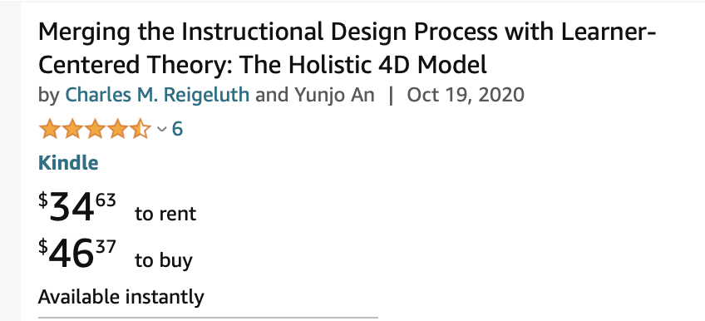
Challenges for the Learner
How to find learning resources for one’s learning goals
Counterpart to Amazon and the App Store
How to judge the quality of the resources
User reviews
Expert reviews
Notes:
Imagine yourself as a learner. What are the challenges you face?
You have just decided what you want to learn – your goals. Your first challenge is to find some good learning resources to meet those goals. So, what search tools do you need - to find those resources? Let’s look at how others find things they need, and see how we can adapt them to lifelong education.
How about Amazon or Alibaba? You enter the name of a product like bird houses, and it gives you lots of choices – over 2,000 in the case of bird houses. Could we have a similar tool where you enter your learning goals, and it gives you lots of choices for your learning experience? Like the App Store and Google Play, some of those learning experiences might be free and some for a fee.
Your second challenge is how to judge the quality of the learning resources so you can decide which one to use. An Amazon-like tool would, of course, have user reviews and ratings. But it could also be linked to something like Consumer Reports that gives expert reviews and ratings, as well. While beyond the scope of a learning-experience designer, if a university or a nonprofit or a business would create such a tool, it would be a huge benefit to lifelong learners.

Slide 5
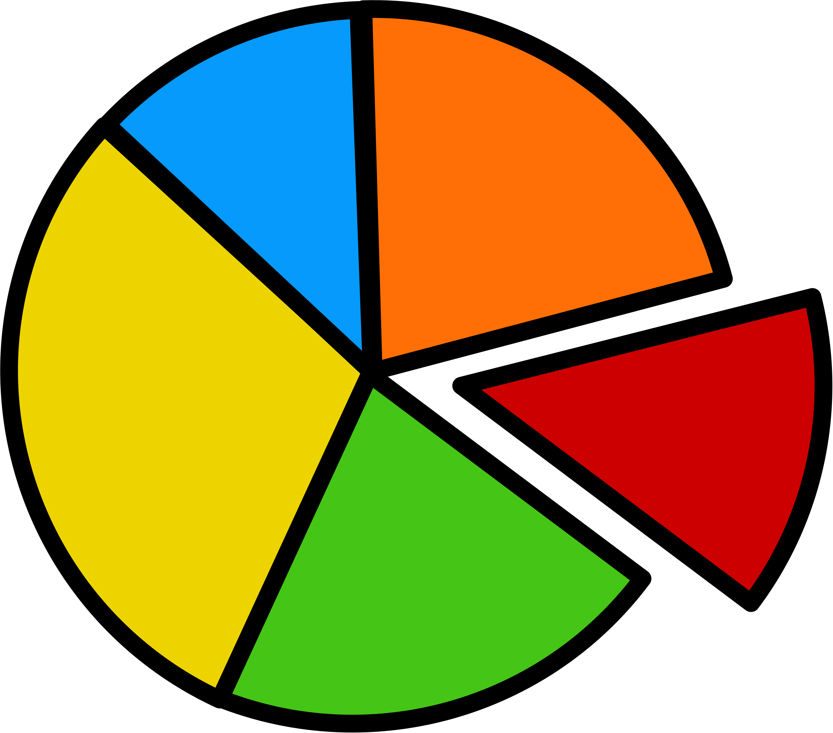
Challenges for the Learning-Experience Designer
Learning goals
and learners
Fuzzy vision of your instruction
Scope
Levels
Chunks
Motivation
Notes:
Let’s turn to challenges for the instructional designer, or learning-experience designer. You have to decide which learning goals you are going to address. You could pick anything! Perhaps you see a particular need that you would like to address. Or you may see a pressing societal need. Or maybe you want to do a little research to identify a need that has a large audience, so you can make more money or have a broader impact – in which case you might want to conduct a survey.
But it should be apparent that to identify learning goals, you also need to identify an audience who is interested in those goals, and you need to figure out why they are interested in those goals. That will help you address motivation.
Once you have decided on the learning goals and target audience, you need to create a fuzzy vision of your instruction. This includes deciding on answers to broad questions like, “What will be the scope of this instruction? Are there different levels of competence I should address?
What might bite-sized chunks – or learning experiences – look like?
And, perhaps most importantly, how will I motivate the learners to complete the instruction? As I mentioned earlier, in lifelong learning, motivation is more important than ever, because learners can and will quit at anytime.

Slide 6
Challenges for the Learning-Experience Designer
Motivation (McClelland)
Need for achievement
Need for power
Need for affiliation
Notes:
So, motivation is perhaps the most important consideration for creating a fuzzy vision of your instruction. McClelland’s Needs Theory identifies three great human motivators but recognizes that different people have differences in the strength of their motivation for each, so it is wise to address all three.
One is need for achievement. People are motivated by accomplishing things they value. It contributes to a sense of self-worth. A powerful way to tap this motivation is project-based learning – also called experiential learning or learning by doing. But not all projects are equal. They must be interesting to the learner. While some fantasy projects can be motivational, it is more likely that authentic projects related to the learner’s interests will almost always be better. Since different learners may have different interests, I recommend offering a variety of projects for learners to choose from for meeting any given learning goal. While this takes more work than just designing one project, it can make a huge difference to learner motivation. Also, having a scoring system related to project achievements can spur the achievement motive.
A second of McClellan’s three motivators is need for power. Again, some learners are motivated more by this need than others. An effective way to tap into this motivation is to design self-directed learning. Allowing learners to choose among several projects is one way to do this. Also, offering more than one project helps learners to be able to transfer their skills to different situations. Other important ways to empower and thereby motivate your learners include: giving them the power to decide when to learn – to be able to pause their learning at any time that an interruption pops up in their lives – and to be able to assess their own learning.
McClellan’s third motivator is need for affiliation. This is why collaborative gaming is such a big thing. Having a teammate or two on a project can provide a sense of connection, a sense of duty to fulfill one’s part and not procrastinate, and a measure of feedback and support that motivates many people. Your instruction could have a feature that helps match up teammates who are interested in the same project at the same time.

Slide 7
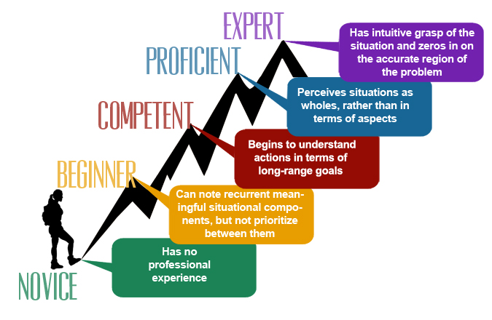
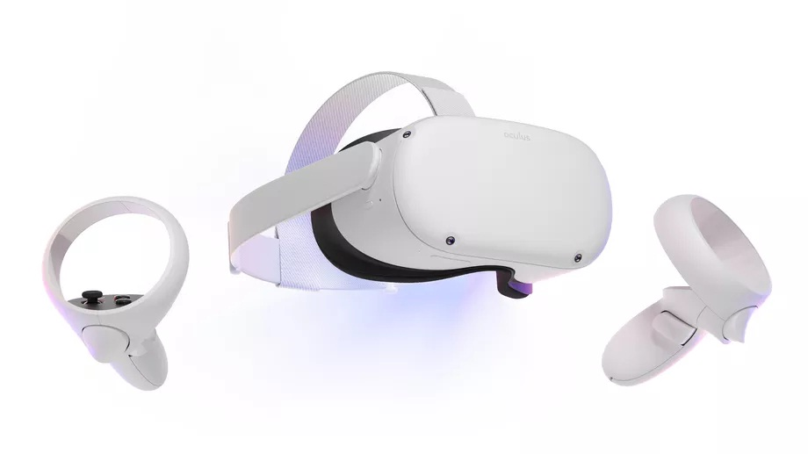
Challenges for the Learning-Experience Designer
Motivation
Multiple levels of learning/mastery/certification
Simplifying Conditions Method
Authentic learning experiences: VR and AR
Notes:
A technique many game designers use is levels of achievement, where players can unlock the next level if they perform well. The same works very well for lifelong learning goals, which typically have many levels of expertise.
In my latest book, I provide guidance for designing such levels using the Elaboration Theory’s Simplifying Conditions Method. It is based on the understanding that some versions of a complex task are much simpler to perform than are others, and that you can design a sequence by identifying the conditions that make those versions simpler. For example, in learning to drive a car, the task is much simpler when the transmission is automatic rather than manual, when there is no traffic, when you don’t have to parallel park, when you don't have distracting passengers, and so on. So, you could have one level of mastery for driving with an automatic transmission, no traffic, good weather, no parallel parking, and no distracting passengers. And you could have additional levels of mastery when you eliminate each of these simplifying conditions. In my book, I offer helpful guidance for identifying conditions that simplify a complex task so you can design increasingly complex learning experiences for the task, representing correspondingly higher levels of expertise and mastery.
I already mentioned that authentic projects tend to be more motivational, but they also make it easier to transfer skills to the real world, which lifelong learners tend to value. In addition to the nature of a project’s design being more authentic, you can use virtual reality to further increase the authenticity of a project and make it more immersive. You can also use augmented reality to provide support for learning in a real environment. VR and AR have great potential for enhancing lifelong learning.

Slide 8
Challenges for the Learning-Experience Designer
Fuzzy vision
Content
Task or topic focus
Scope (how much content)
Levels of expertise
Bite-sized chunks
Methods
Motivation
Notes:
So, getting back to your fuzzy vision, in my new book, Yunjo An and I offer a lot of guidance about how to come up with a good fuzzy vision of your instruction. That fuzzy vision will be influenced strongly by the kind of learning you aim to develop.
We refer to this as the content for your instruction. We distinguish between two kinds of content: task expertise, which entails learning how to do things, and topic expertise, which entails coming to understand concepts and principles. Often, both kinds of expertise are important content, but one is usually primary and the other secondary. The kind of expertise has a strong influence on what your learning experiences should be like, both in terms of what you teach and how you teach it. For your fuzzy vision, don’t get bogged down in details. Just get a general sense of the tasks or topics –
their scope (in other words, how much content you will include in your instruction),
the levels of expertise relevant to your learners, and
what bite-sized chunks they can be addressed in.
Then think about your methods, beginning with motivation: how you will create an immersive project environment, the technologies you will use, whether to use simulations or games, what elements of self-direction to use, whether to use team-based projects, and so forth.

Slide 9
Challenges for the Learning-Experience Designer
Motivation is key
Need for achievement
Projects, immersion, certification
Need for power
Time-flexibility, self-direction
Need for affiliation
Teams
Projects can be inefficient and frustrating.
Teammates can be freeloaders.
Notes:
So, at this point, we have focused on the importance of motivation in lifelong learning.
We have seen that the need for achievement can be addressed by project-based learning, an immersive project environment, and levels of certification.
Need for power can be addressed by bite-sized learning experiences and self-directed learning, with the ability to pause and resume project work at anytime.
And need for affiliation can be addressed by arranging for learners to work together in project teams.
But, despite all its benefits for motivation, transfer, and retention – project-based learning can be inefficient and frustrating, with a lot of time spent “spinning your wheels”, and teammates can be freeloaders, not pulling their fair share of the work and learning. So, let’s look at how to solve these challenges.

Slide 10
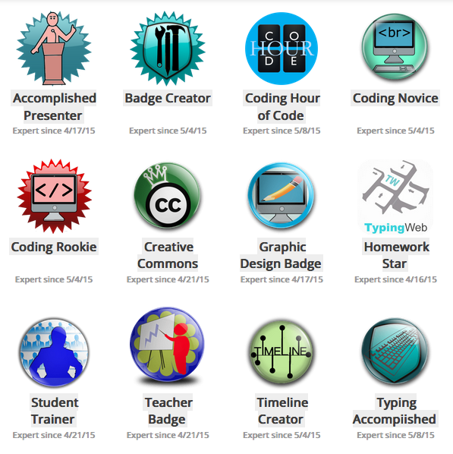
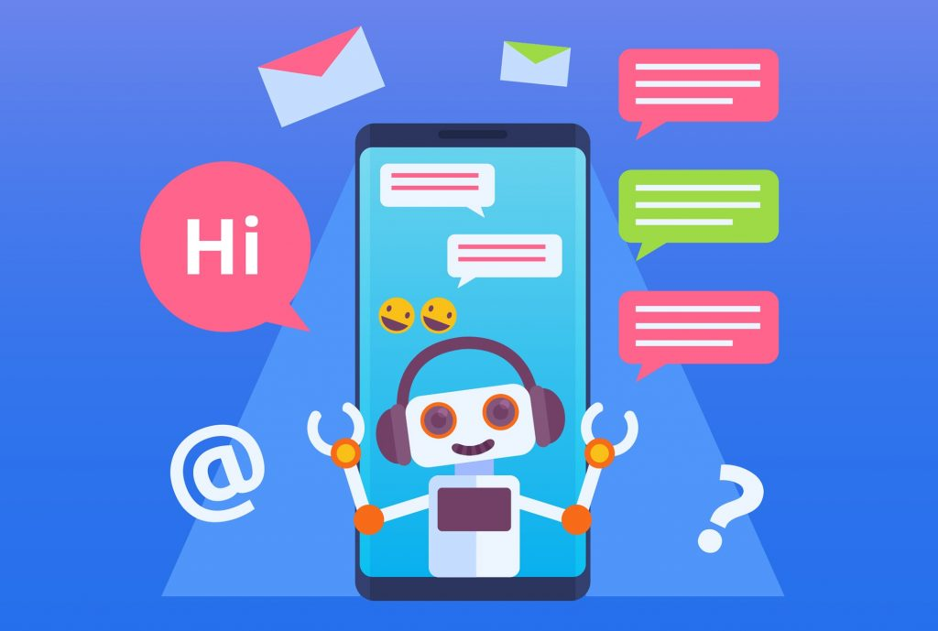
Challenges for the Learning-Experience Designer
Scaffolding – Just-in-time tutorials
Demonstrations with explanations (as in Khan Academy)
Practice with immediate feedback
Artificial intelligence
Notes:
The solution is to provide a certain type of scaffolding to support learning during a project. Whether the focus is on performing tasks or developing deep understandings, like helping a learner develop a complex causal model, tutorials offered just-in-time during a project greatly improve the efficiency, effectiveness, and even motivational effects of the learning experience.
Demonstrations with explanations, as in the Khan Academy, and practice with immediate feedback are all the more powerful when the learner knows that the skills or understandings will be highly valuable to them for their next step in the project. Furthermore, the practice allows the learner to gauge their level of learning, offering a degree of self-assessment and self-direction. And the practice allows the learner to perform a skill under different conditions, which greatly enhances transfer to a broader range of conditions in the real world than can be achieved by a single project. Finally, given that certification of skills can be a great incentive to engage in a lifelong learning experience, a learner can practice a skill in a tutorial until the criterion for mastery has been reached, typically 10 correct items in a row, and you can then automatically award a digital badge to the learner.
This way, freeloaders won’t get certification from the accomplishments of their teammates. They will have to meet the criteria for mastery in their own tutorials. Furthermore, self-direction can allow the learner to jump back and forth between demonstrations with explanations, and practice with immediate feedback, as needed.
Also, artificial intelligence can be used to make the tutorials intelligent. Such tutorials can learn what kinds of explanations best enhance the demonstrations for a given learner, and tailor explanations to the learner’s interests and learning preferences. Intelligent tutorials can also coach the learner’s use of self-direction skills, so they become better lifelong learners. This requires creating an account for each learner.

Slide 11
Challenges for the Learning-Experience Designer
Scaffolding – Just-in-time tutorials
Apply a skill: Demonstrate + explain, practice + feedback
Understand causal relationships: Predict, Explain, Solve
Examples + explanation, practice + feedback
Understand conceptual relationships:
Superordinate, coordinate, sub-ordinate, analogical, experiential
Context, compare/contrast, parts/kinds, analogy, examples
Remember information: Associations, verbal chains
Presentation, practice, repetition, prompting, mnemonics
Social-emotional learning (SEL)
Notes:
So, what should these just-in-time tutorials be like? The effectiveness of a tutorial depends mostly on the nature of what is being learned – the kind of learning.
For example, to learn a skill, it helps to have a demonstration of how the skill is done, along with an explanation of how to do it. We call this an example with simultaneous generality. It also helps to have opportunities to practice doing the skill, along with immediate feedback that confirms correct performance or provides a hint or other information to help the learner figure out what they should have done differently. We call this practice with feedback.
In contrast, to develop an understanding of causal relationships - which is perhaps the most important kind of learning - it helps to first determine how the understanding will be used in the real world. There are three major ways. One is to make predictions: given an event, what will its effects likely be? For example, if the price of a product increases, what effect will this have on the supply of the product and demand for the product? A second way is to give explanations: given an event, what were likely its causes? For example, why did the price of potatoes go up this fall? The third major way to use causal relationships is to solve problems: given a desired situation, what causes, when implemented, are likely to attain that desired situation? For example, how could a government reduce the demand for gasoline? Sometimes only one use is important, and sometimes all three uses are important: prediction, explanation, and solution.
Once you determine the important uses, you can provide examples of these uses with an explanation of what is happening. You can follow this with incomplete examples – that is, cases where the learner needs to make the prediction, give the explanation, or come up with the solution. All such practice should, of course, be followed by immediate feedback.
Another important kind of learning is understanding concepts. This can get complicated, because there are many different dimensions of conceptual understanding, each of which is based on a different kind of relationship among concepts. For example, one might be interested in the concept of civil wars – what are they? The concept of war is superordinate to civil war, so it might be helpful to teach that a civil war is a kind of war. This instructional strategy is called context. It might also be helpful to compare and contrast it with a coordinate concept, like revolutionary war. Or you might want to identify its various kinds or parts. What are the parts of a revolutionary war? Are there kinds of revolutionary wars? Perhaps it would help to understand the concept by using an analogy, like comparing it to a family feud. And of course, seeing a concrete example provides another dimension of understanding. So, as a designer, you first need to identify the dimensions of understanding that are important for the learner, and then select the appropriate instructional methods.
Perhaps the easiest – and greatly overused – kind of learning is remember-level learning. It is the easiest to teach and test, but it is often the least useful kind of learning. There are two major kinds of remember-level learning: One is associations, where two or more items are paired, like remembering the capitals of different countries. The other is verbal chains, like a poem. While there are some differences in how they can be taught most effectively, there are many common methods.
Obviously, you need to present the information, and you should provide practice remembering it. And repetition of both the presentation and practice helps a lot. It also helps to provide prompts if the learner struggles, like saying “It begins with a T.” And mnemonics can be very powerful, like “ROY G. BIV” for remembering the order of colors in the rainbow.
In addition to these kinds of learning, there is the affective domain, recently called social and emotional learning. Dispositions are a major focus here, and they are primarily made up of attitudes, values, morals, emotional awareness, and social skills. Each of these different kinds of learning requires very different methods of instruction in your tutorials. We provide guidance in our new book on how to teach each of these important kinds of learning. In sum, just-in-time tutorials provide a great way to accelerate the learning process, reduce learner frustration, improve transfer of skills and understandings to the real world, and certify competencies.

Slide 12
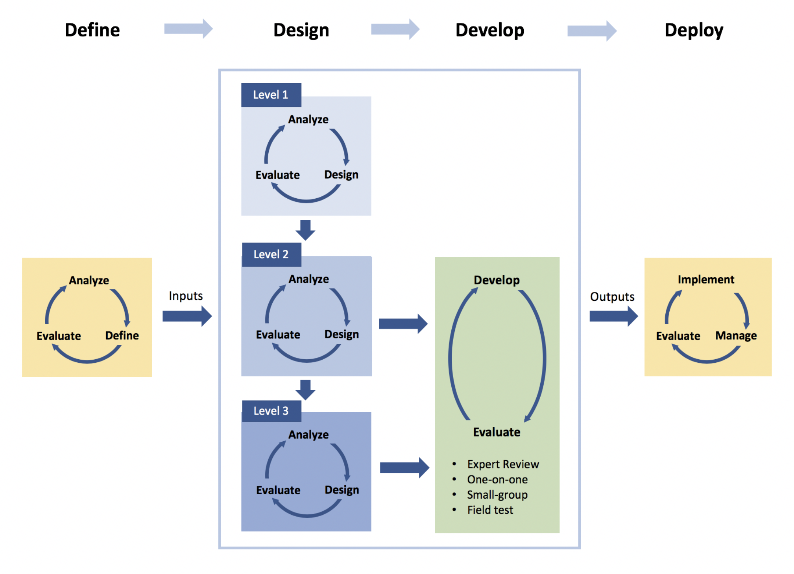
Help for the Learning-Experience Designer
Navigating the Design Process
Holistic 4D Model
Top-level design: Create a fuzzy vision
Learning goals
Audience
Scope
Bite size
Sequence of bites
Notes:
Now, one thing is to have a sense for what a good lifelong learning experience should be like. Another is to know a good process to create it. This is the difference between instructional theory – which offers guidance on which methods to use in different situations – and the instructional design process – which offers guidance on how to do your analysis, design, development, implementation, and evaluation. The former is like a blueprint that an architect creates, and the latter is like a contractor who builds the building.
In our new book, Yunjo An and I offer much guidance about how to conduct the design process to create the kinds of learning experiences I have described here. You can see that there are three levels of design, to create a more holistic design process.
After defining the project, the design process begins by offering guidance for designing a fuzzy vision of your instruction, which includes deciding which learning goals to address in your learning experiences, as well as the audience, scope, bite sizes, and sequence of bites – all on a fuzzy level. This is the top, most-holistic level of design, or Level 1 as shown here.

Slide 13
Help for the Learning-Experience Designer
Navigating the Design Process
Mid-level design: Work out some details
Learning goals, audience, scope, bite size, sequence
Variety of projects for each level of competence
General design of each project
Notes:
On the next level of design, called the mid-level or Level 2, you work out some details on all of the fuzzy vision, including the full variety of projects for each level of competence, given the variations in performance that exist in the real world (like driving with an automatic shift and a manual shift, experiencing no traffic and heavy traffic, and so on). Then you design each project from the learner experience perspective – in still fairly fuzzy terms.

Slide 14
Help for the Learning-Experience Designer
Navigating the Design Process
Lower-level design: Work out remaining details
Design all aspects of each project
Design all JIT tutorials – for all projects, on all levels of competence
Formative evaluations throughout the process
Consider using ChatGPT or Bing
Notes:
On the lower level of design, you flesh out all the specs for all the projects on each level of competence.
Then you design the just-in-time tutorials for all competencies and deep understandings that are needed for each project, beginning with practice and feedback. You begin design of just-in-time tutorials by identifying the kind of learning that each competency or understanding entails. Since different mental processes are required for different kinds of learning, my new book offers guidance for the activities (or instructional methods) that will best spur the appropriate mental processes.
Of course, you should conduct formative evaluations throughout this design process.
You should also consider using ChatGPT or Bing to help with these design tasks.

Slide 15
Conclusion
Good lifelong education is not easy to design.
Motivation is key.
Merging the Instructional
Design Process with
Learner-Centered Theory:
The Holistic 4D Model
Charles M. Reigeluth
Yunjo An
Notes:
In conclusion, good lifelong education is not easy to design. Motivation is key, because your learners can quit anytime. Engaging projects related to the learner’s interests are essential, along with learner self-direction and collaboration. This addresses need for achievement, power, and affiliation. But even knowing that these are important, it is difficult to create such instruction.
My latest book offers much guidance to help you succeed. Also, a platform like Amazon or Alibaba would do much to help learners find good learning resources. I wish you all the best in your quest to create good lifelong learning experiences. I would be delighted to respond to any comments or questions you may have.

