Slide 1
Rethinking, Redesigning,
Reframing (RRR) with the
Competency-Based Paradigm of Education and Training
Charles M. Reigeluth
Professor Emeritus
Instructional Systems Technology
Indiana University Bloomington
reigelut@iu.edu
Notes:
Hello

Slide 2
Overview
1. The Need for RRR
2. The Means
3. The ID Process

Slide 3
1. The Need
For Rethinking, Redesigning, and Reframing (RRR)
Make learning easier, faster, less expensive, and more enjoyable
Make learning environments more effective, efficient, and enjoyable (3E)
Better utilize powerful new tools (e.g., AI) to accomplish this
Notes:
Did I leave anything out?

Slide 4
2. The Means
Don’t force learners to move on before they have mastered it.
Mastery learning (Benjamin Bloom, Carroll, Block)
Competency-based education
Learning-based student progress
Why was time-based learner progress so widespread?
Notes:
How can we accomplish this?
The most important thing ...

Slide 5
2. The Means
Don’t force learners to move on before they have mastered it.
How can we make this work? - With teacher-centered instruction?
Paradigm change – systemic change
  Instruction, assessment, recordkeeping, organizational structure
  Motivational system (intrinsic vs. extrinsic)
  Roles of teachers, learners, and technology
This paradigm change requires …
  PBL - Learning by doing (vs. being told)
  PL - Personalized learning (vs. standardized learning)
  CL - Collaborative learning (vs. alone)
  SDL - Self-directed learning – agency (vs. teacher-directed)
Notes:
• All subsystems

Slide 6
2. The Means
Don’t force learners to move on before they have mastered it.
How can we make this work?
Transform motivation: It requires moving to intrinsic motivation: learners’ needs for achievement, affiliation, and power (McClelland).
Change roles: It requires new roles for instructor, learner, technology.
  Instructor: Guide on the side; Learning – for, about, with, and from the learner.
  Learner: Self-directed (agency, initiative)
  Technology: Primarily for the learner (four roles for student learning: planning, instruction, assessment, and recordkeeping for learning).

Slide 7
2. The Means
In sum, for public education
No grade levels (only learning-based progress – achievement levels)
No grades (only mastered or not yet mastered)
No classrooms (only studios or workshops – PBL environments)
No teachers (only guides – mentors, coaches, problem curators)
Same for training contexts – package deal (different paradigm)

Slide 8
2. The Means
For a more detailed designer’s perspective (design theory)
Guidance to design collaborative, self-directed projects (R, AR, VR)
The selection/progression problem with PBL –
The assessment problem –
The transfer problem –
The automatization problem –
The personalization problem –
The team problem –
a. SCM sequence
b. Individual JIT tutorials
c. Divergent JIT tutorials
d. Timed JIT tutorials
e. Personalized tutorials
f. Selection, forming, norming
Notes:
Have you seen much guidance for designing projects?
What is the selection/progression problem?
What is the assessment problem?
What is the transfer problem?
What is the automatization problem?
What is the personalization problem?
What is the team problem?

Slide 9
3. The ID Process
Problems
Solutions
Beginning the design process with tiny pieces of content doesn’t work.
Saving all the evaluation for the end doesn’t work well.
A holistic design process – 3 levels of design (more or less)
Many analysis-design-evaluation (ADE) cycles on each level of design (bigger or smaller chunks)
Notes:
How does the ID process need to change ...?
2. Why?
Advantages and disadvantages of smaller or larger chunks?

Slide 10
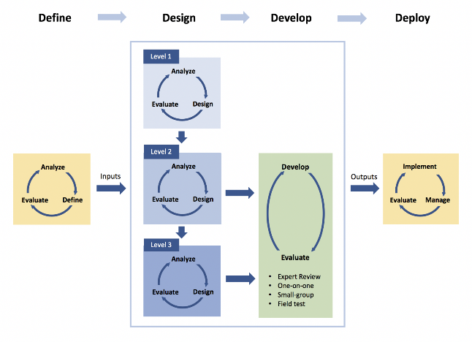
The Holistic 4D Process

Slide 11
3. The ID Process
Problems
Solutions
Beginning the design process with tiny pieces of content doesn’t work.
Saving all the evaluation for the end doesn’t work well.
The nature of the ID process is different for different instructional methods.
A holistic design process – 3 levels of design. (More or less?)
Many analysis-design-evaluation (ADE) cycles on each level of design. (Bigger or smaller chunks?)
Integration of learner-centered instructional theory with the ISD process.
Notes:
Why?

Slide 12
3. The ID Process
Problems
Solutions
Some learning situations involve learning topics (understandings), rather than tasks (skills).
People assimilate new knowledge into broader knowledge (schema).
Not all performance problems are due to lack of knowledge or skills.
Guidance for topic expertise as well as task expertise (Behaviorist roots) (Procedural vs. heuristic knowledge)
Elaboration Theory sequencing (zoom lens analogy), Holistic ID process
Performance analysis and non-instructional interventions
Notes:
What is the difference between topics and tasks?
Ideational scaffolding (Ausubel). Assimilation, Tuning, Restructuring. What is assimilation? Tuning? Restructuring? Most common?

Slide 13
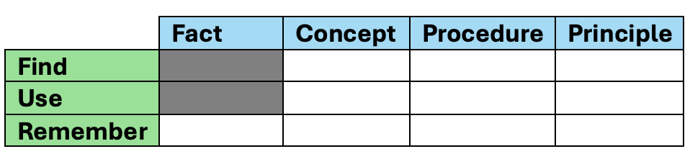
3. The ID Process
Other useful features for the ID process
Rapid prototyping
Designer objectives and demonstration objectives
Templates for design documents
ID process evaluations
Objective
Test
Instruction
Consistency and adequacy
Notes:
Teaching the right things (consistency)
Teaching it well (adequacy)

Slide 14
Summary
The need
The means
The ID process
AI can be a powerful tool for instructing, but …
AI can be a powerful tool for providing appropriate design, but ...
Four functions for technology to support student learning:
Planning, instruction, assessment, recordkeeping for student learning
Notes:
Requires appropriate design (It can provide JIT coaching and instructing during project work, etc.)
Must clearly specify the learner-centered paradigm (it can design projects, coaching, instructing, assessment, etc.) For both of these, you need informed prompt engineering.
AI can be a powerful tool for all four functions, not just instruction.

Slide 15
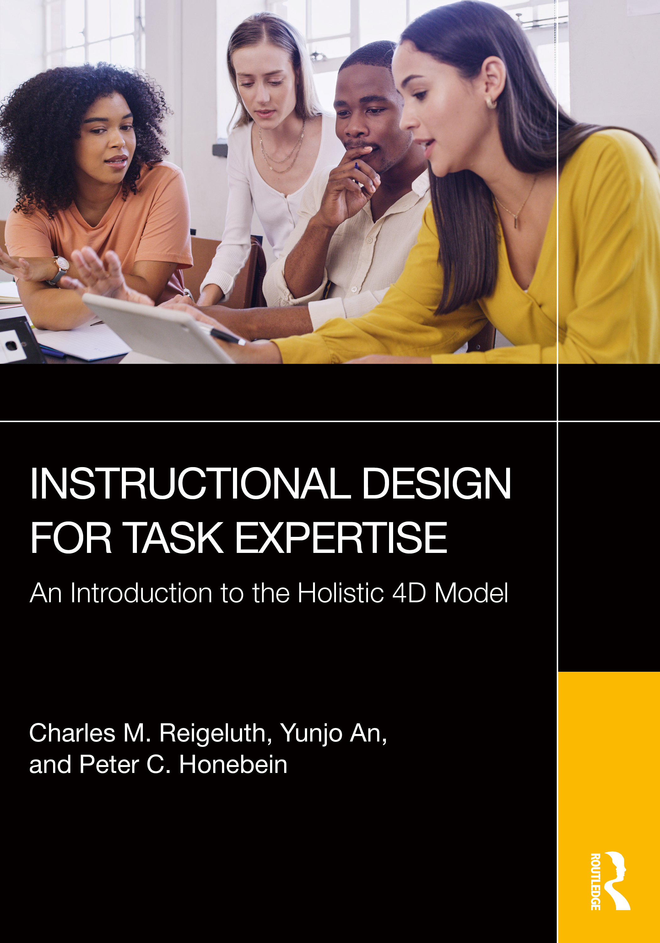
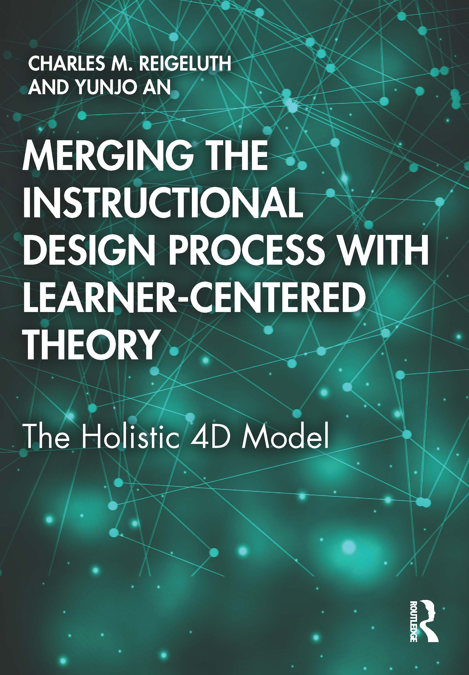

Resources www.reigeluth.net (for all pubs)
2026 2021 2020
Updated guidance for Same, but includes less What the new paradigm
designing personalized detailed guidance and should be like (vision) and
PBL and CBE for task includes guidance for how to transform to it (action)
Expertise (Holistic 4D) topic expertise

Slide 16
Any more Comments or Questions?
Charles M. Reigeluth
Professor Emeritus
Instructional Systems Technology
reigelut@iu.edu
I am happy to work with any students who are interested in the things I’m working on. Just contact me with your thoughts.

